Slide 1

Fake Review Identification &
Application in Recommender System
- A study inspired by

Slide 2
Agenda
Business Understanding
Amazon’s current platform and recommendation system
Need for identifying fake reviews
Data
Understanding
Text analytics and feature extraction
Fake vs. non-fake reviews analysis
Modeling & Evaluation
Fake reviews detection model comparison
Recommender system types and comparison
Deployment & Conclusion
Integration of models into current platform
Future improvement recommendations

Slide 3
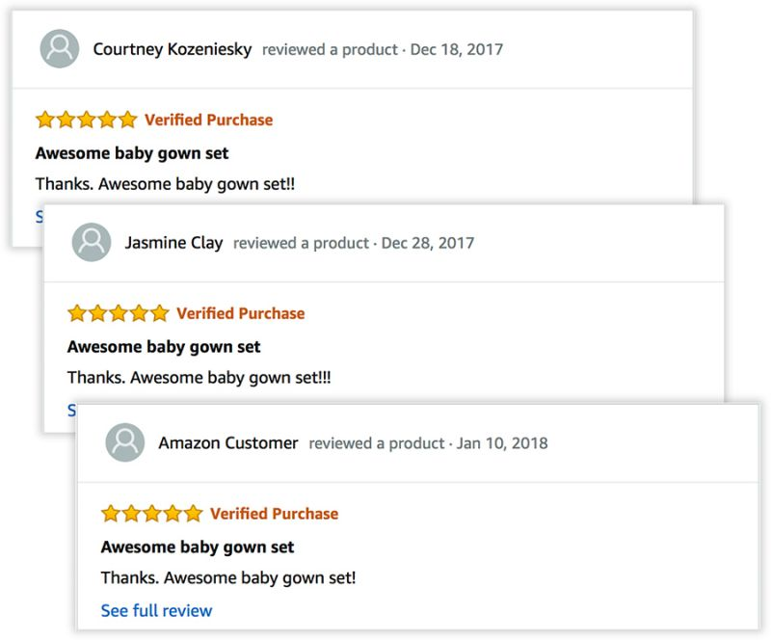
Fake reviews at Amazon affect its recommendations
33% of online shoppers refuse to buy products that do not have positive reviews
Rise in the number of fake reviews reduce the platform’s ability to accurately show the views and opinions of the customers
Relying on fake reviews for recommendations diminish the platform’s ability to make relevant recommendations
Advantages of detecting fake reviews:
Integrity of Reviews
Better Recommendations
Identifying and removing fake reviews increase customers’ trust on reviews
Relying on real reviews will improve the performance of Amazon’s recommendations

Slide 4
Used data from two sources
Deception Dataset
Luxury Beauty Reviews
21,000 Amazon Reviews
Balanced dataset with 50% fake review rate. Data is equally divided among 30 categories. Includes 7 features and one target variable.
Source: GitHub Repository
574,288 Amazon Reviews
Reviews on products within the luxury beauty category. Contains information on product, reviewer, purchase and usefulness vote.
Source: University of California, SD
Notes:
Deception dataset: https://github.com/aayush210789/Deception-Detection-on-Amazon-reviews-dataset
Luxury Beauty Reviews data: http://deepyeti.ucsd.edu/jianmo/amazon/index.html

Slide 5
Our two-step modeling process
Training Data
Training Data
Deception Dataset
Target variable (Fake or Not)
Features common to test data
Features extracted from text analytics
Filtered Luxury Beauty Dataset
Filtered for non-fake labels
Information on products, ratings and reviewers
Fake Review Prediction Model
Recommenders System
Filtering
Luxury Beauty
Product Recommendations for Amazon Customers
Model Deployment
Predictions
Method
Luxury Beauty Reviews
Features common to train data
Features extracted based on training data
No label for target variables
Luxury Beauty Reviews
Labels (Fake or Not Fake) for test review data
Types of Recommender System
Popularity
NormalPredictor
KNN
SVD
NMF
Slope One
Co-Clustering

Slide 6
Focus: Text Analytics
Deception Dataset
Luxury Beauty Reviews
21,000 Amazon Reviews
Balanced dataset with 50% fake review rate. Data is equally divided among 30 categories. Includes 7 features and one target variable.
Source: GitHub Repository
574,288 Amazon Reviews
Reviews on products within the luxury beauty category. Contains information on product, reviewer, purchase and usefulness vote.
Source: University of California, SD

Slide 7
Feature Engineering from Reviews
Readability
- Number of sentences
- Flesch–Kincaid grade level score
Length
CAPS
Punctuation
- Number of Emojis
- Count of punctuation marks
☺ ☹ 😐
. , ! ?:;’
Complexity
- Count (stop words, capital letters)
- Character length of reviews
Bag of Words
- Count of 100 most common words in beauty reviews

Slide 8
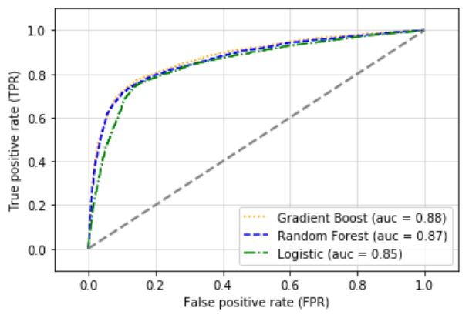
Modeling Exploration
ROC shape similar for all classifiers
Chose the model with highest AUC
Decision Tree
Gradient Boost
Model Choices
Random Forest
Logistic
Metrics Considered: F-measure, Accuracy, Precision, Recall

Slide 9
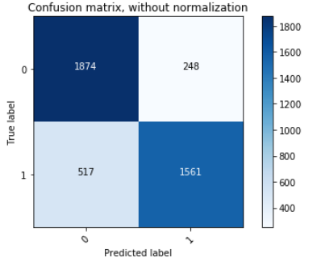
Gradient Boosted Trees Performance
Test Performance
Insights
F1: 0.82
Accuracy: 0.82
Positive Recall: 0.75
Negative Recall: 0.88
Positive Precision: 0.86
Negative Precision: 0.78
Genuine review biased
Verified purchase has most predictive power
Punctuation, summary length and FK grade score were other important predictors

Slide 10
Focus: Recommender’s System
Deception Dataset
Luxury Beauty Reviews
21,000 Amazon Reviews
Balanced dataset with 50% fake review rate. Data is equally divided among 30 categories. Includes 7 features and one target variable.
Source: GitHub Repository
574,288 Amazon Reviews
Reviews on products within the luxury beauty category. Contains information on product, reviewer, purchase and usefulness vote.
Source: University of California, SD

Slide 11
Design of two recommender system to compare difference in results
Objective
Identify whether fake reviews impact Amazon’s recommender system results
All Reviews Recommender System
Build a baseline recommender system with data on all reviews
Optimize and fit recommender system to all reviews dataset
Filter Fake Reviews
Apply our fake review detection model to the entire dataset
Filter out reviews predicted as fake, keeping only the genuine ones
Genuine Reviews
Recommender System
Apply the same recommender system built in step one to the dataset containing only reviews classified as genuine (non-fake) from fake detection model
Results Comparison
Predict recommendations for customers using both recommender systems
Compare output of baseline recommender system with one using filtered data

Slide 12
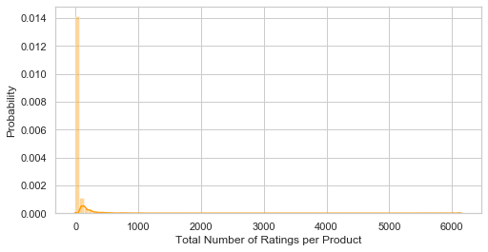
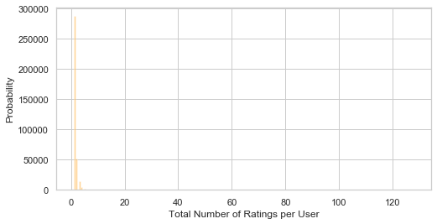
Number of Ratings per Product and Customer
Distribution of Product Reviews
Distribution of User Reviews
Maximum reviews per product is 6,148; Median is 9
Filtered data to include top 25% percentile of products, which are the products with more than 30 ratings
Filtered only a small portion of the total reviews (14% less)
Similar distributions observed in number of reviews per user
Did not exclude customers with fewer reviews to generate recommendations for all customers
Handled specifics in the models as discussed later
Both distributions display long-tail characteristics

Slide 13

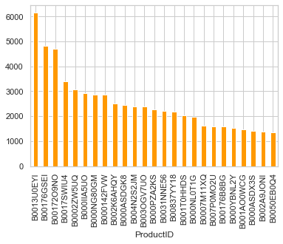

Addressing the Cold Start Problem
Recommend Most Reviewed Products
Top 25 Most Rated (Popular Products)
Cold Start Problem
Collaborative filtering recommender system is inaccurate for new users/items with no or little information
Solution
Recommend the most popular items, measured by number of reviews

Slide 14
Benchmarking of Recommender Systems - Python
SVD is the best performing model
Error goes up
Process
Used RMSE as performance metric for comparison
Results table is sorted based on performance and is based on three folds cross validation
Grid search with 3-folds CV is used to tune the parameters in SVD and KNN
Result
The best model in terms of RMSE is SVD, with lowest RMSE at 1.165
Best parameters: 'n_factors’: 50, 'lr_all': 0.05, 'reg_all': 0.04
Notes:
The table is sorted from lowest RMSE on top, then down to the highest RMSE on bottom. We can see that the best model is KNNBaseline, then comes by SVD, SVD++, and other 3 KNN approach. Regarding the fitting time, KNN family are the shortest as well. However, we only trained the model with their default parameters. Next, we will focus on tuning model parameters, by GridSearchCV, which combines GridSearch and cross validation approaches. The best model regarding rmse is svd, with the loweset rmse 1.165177587018473 with the parameters: 'n_factors': 50, 'lr_all': 0.05, 'reg_all': 0.04.

Slide 15
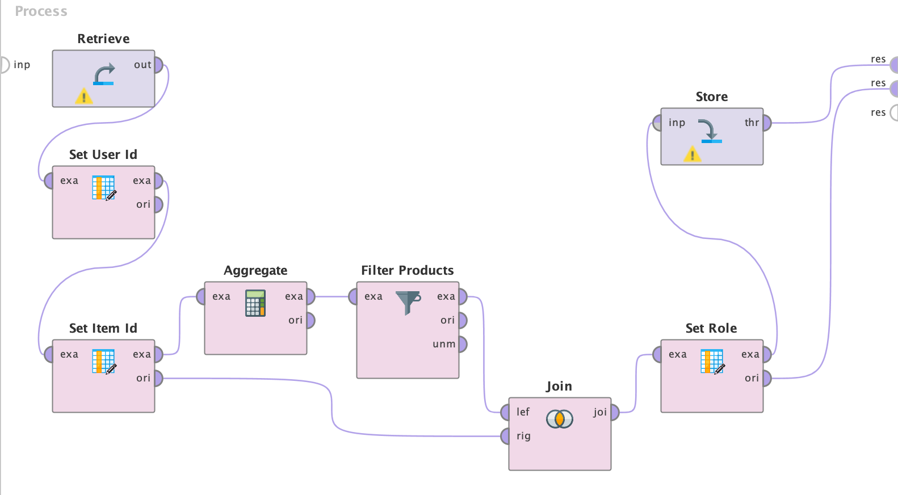
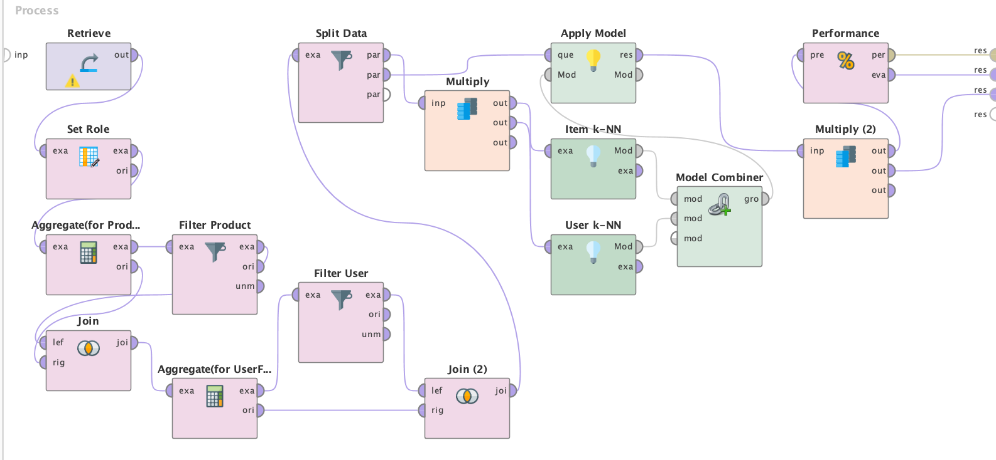
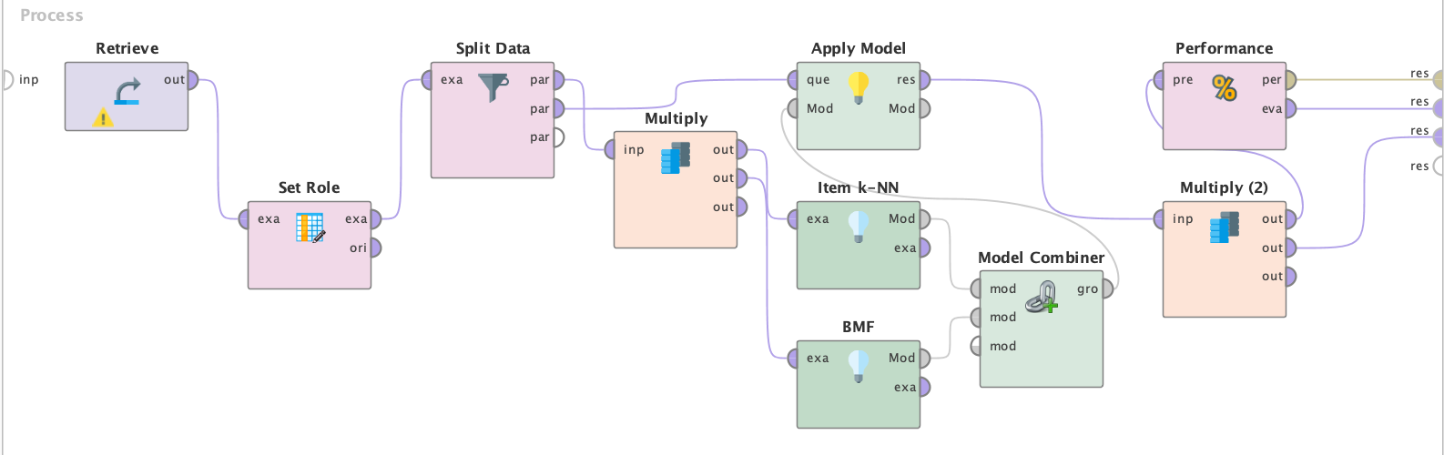
Building Recommender System Models in RapidMiner
Data Preprocessing – Filtering out Product records with less than 30 ratings received
Hybrid Model combing User kNN and Item kNN (additional filtering on User records imposed)
Training-Testing data split across all models
70:30 stratified split
Filtering out products with too few ratings received
Additional filtering on users who made too few ratings for User-kNN specifically
Possible better model performance based on data reliability
Exploitation-Exploration problem
Hybrid Model combing Item kNN and Biased Matrix Factorization

Slide 16
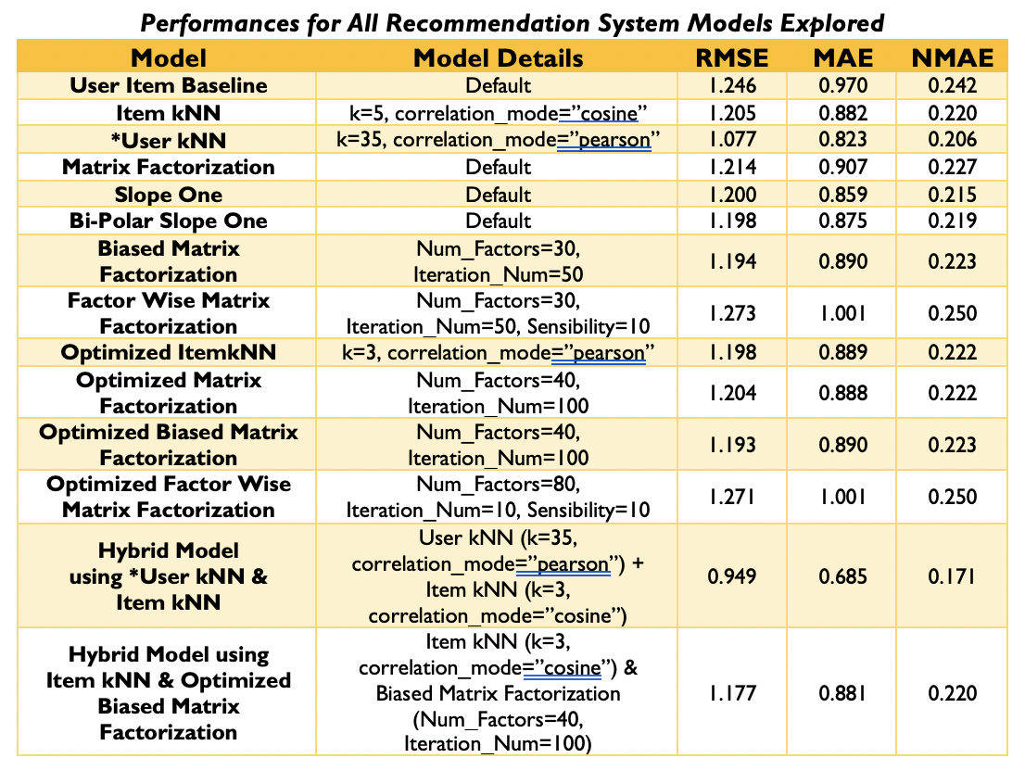
Results of Model Exploration and Tuning - RapidMiner
Most powerful class of models – Hybrid recommenders
Significant improvement in performance over individual models
Performance Metrics
RMSE, MAE and NMAE from Item Rating Prediction operator
Baseline
User Item Baseline (avg. rating plus a regularized user and item bias)
Methods Used
Neighborhood-based: Item & User kNN, ”Slope One” family
Matrix Factorization families of models
GridSearch parameter optimization

Slide 17
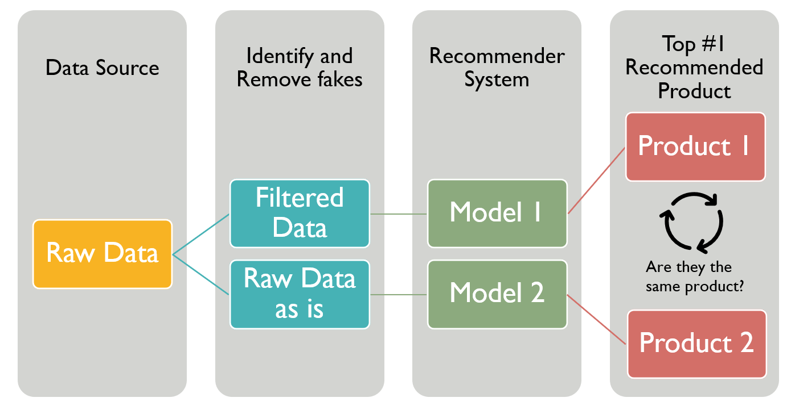
Gauging Effectiveness of Fake Review Detection Model
Does using the fake review detection model make a difference?
Compared recommended products for customers buying the most popular products
Notes:
To perform this test, we choose 23 customers who have bought the most popular products. The reason behind this is that if we remove a few of the reviews from these products, our action will have less impact on them compared to removing the same number of reviews from less popular products. This experiment shows that using data classified as non-fake from our fake review detection model does change the recommendations. The result shows that only 1 out of 23 customers received the same recommended product, showing that model output changes the output of recommender system.
If we relax the constraint of matching to top three products instead of one regardless of orders of recommended products, we will have a total of 138 products (23*3*2) recommended by the two models. If the two models give out the same results, we would have 69 unique products (proportion = 0.5) and if the two models give out totally different results, the proportion will be 1. In our case, the proportion is 0.97 (134/138), which is very close to one. That means the two models have different outputs; hence, our fake detection model makes a substantial difference in recommendations.

Slide 18
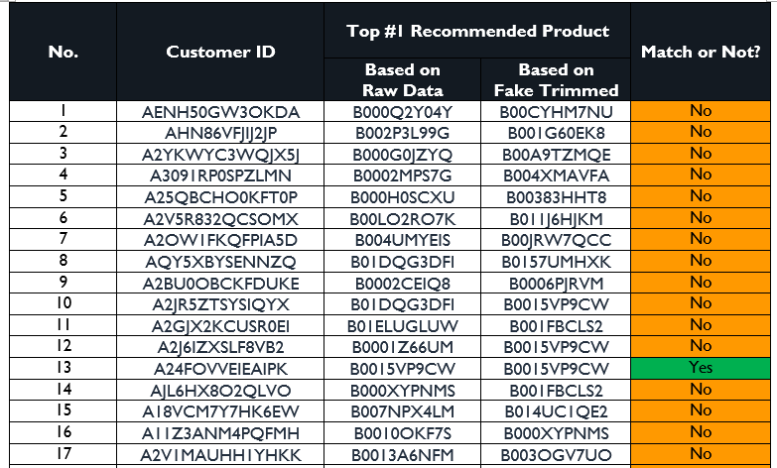
Results of Comparison between Recommender Systems
Fake review labeling and filtering does make a difference
Compared the top recommended product for 23 customers buying the most popular products
Only 1 out of 23 received the same top 1 recommended product
Relaxed the constraints of matching to top 3 regardless of orders of recommended products
97% products recommended by the two recommender systems were different
Notes:
To perform this test, we choose 23 customers who have bought the most popular products. The reason behind this is that if we remove a few of the reviews from these products, our action will have less impact on them compared to removing the same number of reviews from less popular products. This experiment shows that using data classified as non-fake from our fake review detection model does change the recommendations. The result shows that only 1 out of 23 customers received the same recommended product, showing that model output changes the output of recommender system.
If we relax the constraint of matching to top three products instead of one regardless of orders of recommended products, we will have a total of 138 products (23*3*2) recommended by the two models. If the two models give out the same results, we would have 69 unique products (proportion = 0.5) and if the two models give out totally different results, the proportion will be 1. In our case, the proportion is 0.97 (134/138), which is very close to one. That means the two models have different outputs; hence, our fake detection model makes a substantial difference in recommendations.

Slide 19
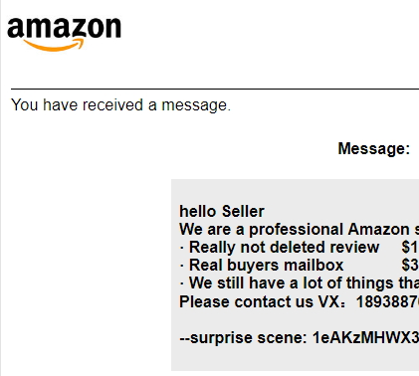
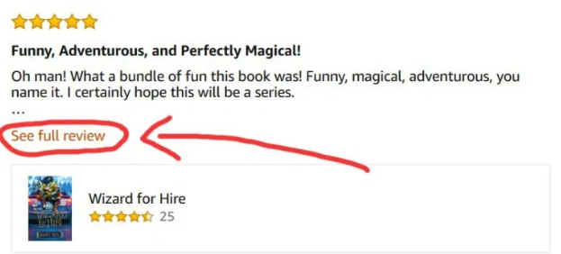
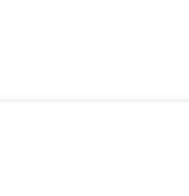
Deployment Options
External Deployment
Internal Deployment
Fake reviews would be filtered out of the datasets where product ratings are used for predictive analytics and recommendations
Message:
Dear customer,
Your review has been identified as unreliable and removed from the platform.
Please contact us if you …
See Reliability Score
Removal of Fake Reviews
Review Reliability Score
Users creating fake reviews would be notified and fake reviews removed from the platform
A reliability score would be provided for each review showing likelihood of being genuine

Slide 20
Deployment Concerns and Improvements
Risks and Concerns
Future Improvements
Ethical Considerations
Predictions do not fully represent business cost of false positives and negatives
Predicting fake reviews relies heavily on accuracy and integrity of training data
Statistical accuracy metrics for Recommender Systems alone
Incorporate probability estimation of fake reviews
Consider seasonality of sales for recommendations
Ensure data for prediction is highly reliable and accurate
Inspect decision support evaluation metrics for Recommender Systems (e.g. Precision@k)
Ethical debate analogous to censoring of ‘fake news’
Cost of false opinions and misrepresentations vs. ethical issue of censoring

Slide 21
Thank You For Watching！

